Slide 1
EUNIC
ECML Professional Network Forum December 2017

Slide 2
Since Language Rich Europe …
… EUNIC has not devoted much attention to language issues!
EUNIC colleagues have asked whether more co-operation with the NPLD (Network to Promote Linguistic Diversity) might be valuable – colleagues’ views? The NPLD is not (yet) a member of the Professional Network Forum, I think.

Slide 3
My day job is with British Council
Three items:
LANGUAGES FOR THE FUTURE: The foreign languages the United Kingdom needs to become a truly global nation [7/10 ‘European’]
English language and medium of instruction in basic education in low- and middle-income countries: a British Council perspective [CLIL]
English Across the Fracture Lines – edited by Beth Erling, who’s just taken up a position at Graz University [subsidiary to local language]

Slide 4
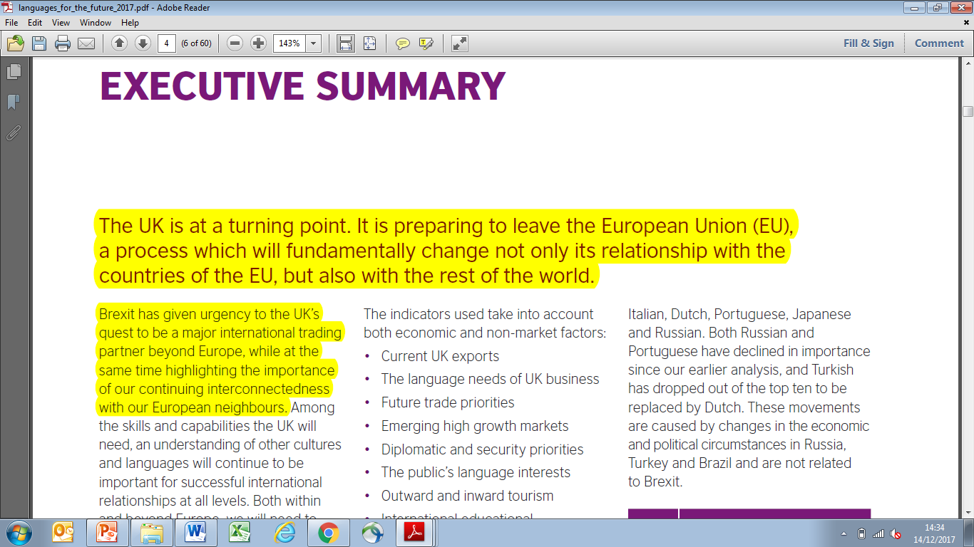

Slide 5
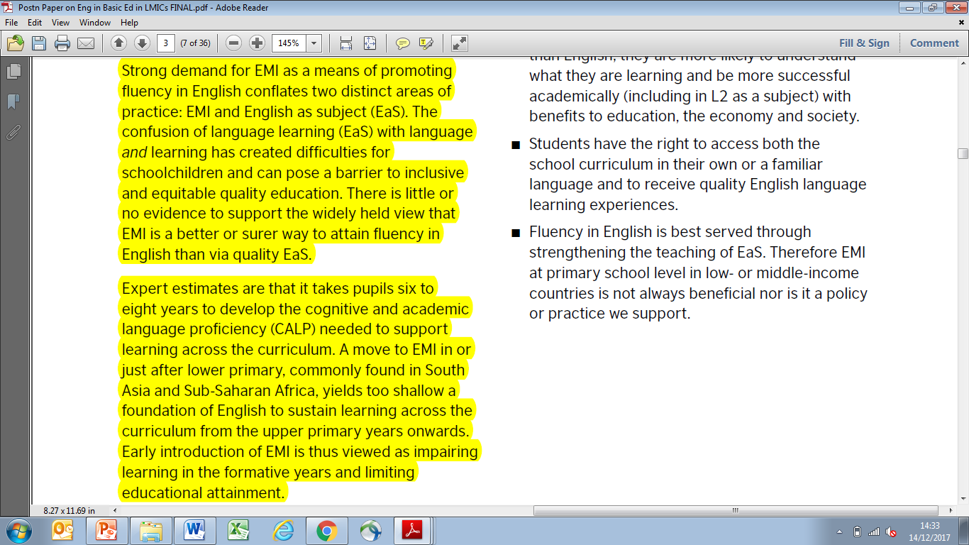

Slide 6
