Slide 1
European Centre for Modern Languages of the Council of Europe
ACTFL Update
December 8, 2016

Slide 2
Updates from actfl
Status of current language learning in US
New! Center for Assessment, Research and Development
Lead with languages

Slide 3
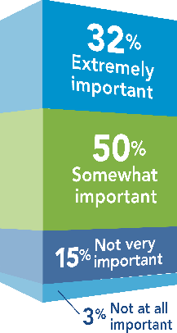
Future Use and Importance of Language Learning (69,870 high school language learning students)
89%of students believe that they
will use the languages they are
learning after high school.
82% of students believe
that Language study
Is important to their abilities
to get jobs in the future.
Findings from myCollegeOptions®/ACTFL research study (2015): National sample includes 69,870 high school language learning students.

Slide 4
Early
Language Learning
Nearly 52% of seniors
say they wanted to
begin language learning
earlier in school and
28% say they may
have wanted to begin
learning earlier.
Findings from myCollegeOptions®/ACTFL research study (2015): National sample includes 69,870 high school language learning students.

Slide 5
Declining College Enrollments in Language Study¹
Aggregate college enrollments in all languages decreased by 6.7% from
1,673,543 in 2009 to 1,563,179 in 2013
The 2013 ratio for modern language enrollments per 100 college enrollments
stands at 8.1%, a decline from 8.7% in 2009 and a continuation of the decline
from the 9.1% ratio in 2006. The 2013 ratio is half of the 1960 ratio of 16.2%.
Findings from myCollegeOptions®/ACTFL research study (2015): National sample includes 69,870 high school language learning students.
¹ The Modern Language Association of America, Enrollments in Languages Other Than English in United States Institutions of Higher Education, Fall 2013, February, 2015 http://www.mla.org/pdf/2013_enrollment_survey.pdf

Slide 6
Introduction

Slide 7
CARD Mission
Support PK-12 schools and institutions of higher education in assessment and articulation
Develop and maintain high-quality language proficiency assessments
Train, certify and maintain highly reliable assessment testers and raters
Conduct research on proficiency and performance outcomes
Collaborate with other language organizations and government agencies
Notes:
to support and promote research in the areas of high quality language teaching and learning, including the implications for teacher education.

Slide 9
What are the Objectives of Lead with Languages?
Increase enrollment and language options in world language programs at all grade levels
Strengthen and expand language programs and their funding
Engage leaders from business, education, government and other stakeholders
Build awareness among heritage populations

